Slide 1


Noida Institute of Engineering and Technology, Greater Noida
Pollution and Solid Waste Management
Unit -IV
Subject Name
Environmental Science
Mrs. Sonali Agarwal
Assistant Professor
Civil Department
Course Details Semester –III/IV

Slide 2
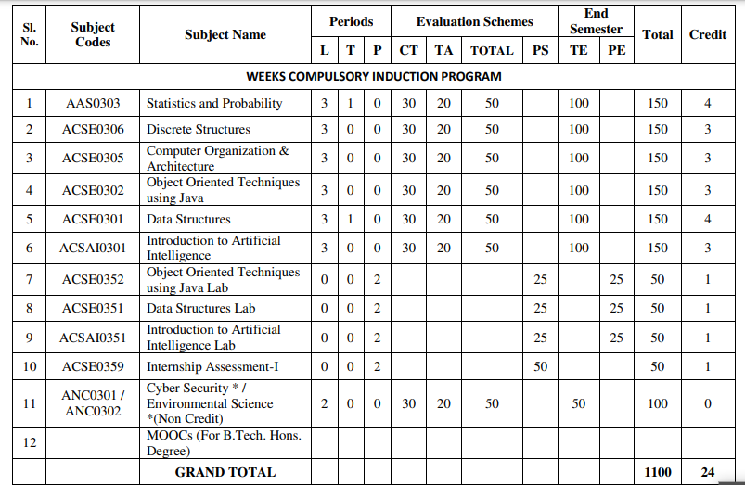
Evaluation Scheme

Slide 3
Syllabus
UNIT-I (Basic Principle of ecology)
Definition, Scope and basic principles of ecology and environment. Ecosystem: Basic concepts, components of ecosystem.
Food chains and food webs. Ecological pyramids, Energy flow in ecological systems, Characteristics of different ecosystems.
Biogeochemical Cycles: Importance, gaseous and sedimentary cycles. Carbon, Nitrogen, Phosphorus and Sulphur Cycles.
Basic concepts of sustainable development, SDGs, Ecosystem services, UN Decade for Eco restoration.

Slide 4
Syllabus
UNIT-II (Natural Resources and Associated Problems)
Natural resources and associated problems.
Forest resources: Use and over-exploitation, deforestation. Timber extraction, mining, dams and their effects on forest and tribal people.
Mineral resources: Use and exploitation, environmental effects of extracting and using mineral resources.
Food resources: World food problems, changes caused by agriculture and over-grazing, effects of modern agriculture, fertilizer-pesticide problems, water logging, salinity.
Land resources: Land as a resource, land degradation, man induced landslides. Equitable use of resources for sustainable lifestyles.
Non Renewable Energy Resources: Fossil fuels and their reserves, Nuclear energy, types, uses and effects,
Renewable Energy Resources: hydropower, Solar energy, geothermal, tidal and wind energy, Biomass energy, biogas and its advantages.

Slide 5
Syllabus
UNIT-III (Biodiversity Succession)
Biodiversity and their importance, Threats to biodiversity, major causes, extinction’s, vulnerability of species to extinction, IUCN threat categories, Red data book.
Strategies for biodiversity conservation, principles of biodiversity conservation in-situ and ex-situ conservation strategies,Mega diversity zones and Hot spots, concepts, distribution and importance.
Succession: Concepts of succession, Types of Succession. Trends in succession. Climax and stability.

Slide 6
Syllabus
UNIT-IV (Pollution and Solid Waste Management)
Air pollution: sources of air pollution, Primary and secondary air pollutants. Origin and effects of SO_{X}, NO_{X}, CO_{X}, CFC’s, Hydrocarbon,, control of air pollution.
Water pollution: sources and types of water pollution, Effects of water pollution, Eutrophication,
Soil pollution: Causes of soil pollution, Effects of soil pollution
Noise Pollution: Major sources of and effects of noise pollution on health,
Radioactive and thermal pollution: sources and their effects on surrounding environment.
Solid waste disposal and its effects on surrounding environment
Climate change, global warming, acid rain, ozone layer depletion,

Slide 7
Syllabus
UNIT-V (Role of Community and Environmental Protection Acts)
Role of community, women and NGOs in environmental protection, Bioindicators and their role, Natural hazards, Chemical accidents and disasters risk management,
Environmental Impact Assessment (EIA)
Salient features of following Acts:
a. Environmental Protection Act, 1986, Wildlife (Protection) Act, 1972.
b. Water (Prevention and control of pollution) Act, 1974.
c. Air (Prevention and control of pollution) Act, 1981. Forest (Conservation) Act, 1980.
d. Wetlands (Conservation and Management) Rules, 2017;
e. Chemical safety and Disaster Management law.
f. District Environmental Action Plan. Climate action plans.

Slide 8
Applications for Emerging Technology
Environmental engineering is the application of science and engineering principles to improve the environment (air, water, and/or land resources), to provide healthful water, air, and land for human habitation and for other organisms, and to remediate polluted sites.

Slide 9
Course Objectives(CO1)
To help the students in realizing the inter-relationship between man and environment and help the students in acquiring basic knowledge about environment.
To develop the sense of awareness among the students about environment and its various problems.
To create positive attitude about environment among the student.
To develop proper skill required for the fulfillment of the aims of environmental education and educational evaluations
To develop the capability of using skills to fulfill the required aims, to realize and solve environmental problems through social, political, cultural and educational processes

Slide 10
Course Outcome
CO 1 | Understand the basic principles of ecology and environment. Ecosystem: Basic concepts, components of ecosystem, food chains and food webs. Ecological pyramids | K1,K2
CO 2 | Understand the different types of natural recourses like food, forest, Minerals and energy and their conservation | K1.K2
CO 3 | Understand the importance of biodiversity, Threats of biodiversity and different methods of biodiversity conservation. | K1,K2
CO 4 | Understand the different types of pollution, pollutants, their sources, effects and their control methods. | K1,K2,K3
CO 5 | Understand the basic concepts of sustainable development, Environmental Impact Assessment (EIA) and different acts related to environment | K1,K2,K3

Slide 11

Topic mapping with CO
Topic | Topic outcome | CO Map | Extend of mapping
Environment and its segment | Students understand the meaning of environment | CO1 | 1
Segment of atmosphere Multidisciplinary nature of EVS Scope and importance of evs | .Students understand different segment of atmosphere Students understand the basic knowledge of basic science Students understand the scope of environmental SC. | CO1 | 1
Food chain and food web | Students understand the definition and types of food chain | CO1 | 2
Ecological pyramid | Students understand the graphical representation of food chain | CO1 | 1
Ecosystem and its types | Students understand the interaction between the biotic and abiotic Components .along its types | CO1 | 1
Components of ecosystem | Students understand the living and non living components | CO1 | 1
Function of ecosystem | Students understand the functions of ecosystems. | CO1 | 2
Forest recourses | Students understand the functions and value of forest | CO1 | 1
Deforestation | Students understand the ill effect and causes of deforestation | CO1 | 1
Mining and transportation activity. | Students understand the ill effects of mining and transportation activity | CO1 | 1
Notes:
Shubhi and Jyoti

Slide 12
Program Outcome (PO’s)
Engineering Knowledge,
Problem Analysis
Design/development of solutions,
Conduct investigations of complex Problems,
Modern tool usage,
The engineer and society,
Environment and sustainability,
Ethics,
Individual and team work,
Communication,
Project management and finance,
Life-long learning

Slide 13
CO-PO Mapping
CO | PO-1 | PO-2 | PO-3 | PO-4 | PO-5 | PO-6 | PO-7 | PO-8 | PO-9 | PO-10 | PO-11 | PO-12
CO1 | 2 | 2 | 1 | 1 | - | 2 | 3 | 2 | 2 | 2 | - | 2
CO2 | 2 | 2 | 1 | 1 | - | 2 | 3 | 2 | 2 | 2 | - | 2
CO3 | 2 | 2 | 1 | 1 | - | 2 | 3 | 2 | 2 | 2 | - | 2
CO4 | 2 | 2 | 1 | 1 | - | 2 | 3 | 2 | 2 | 2 | - | 2
CO5 | 2 | 2 | 1 | 1 | - | 2 | 3 | 2 | 2 | 2 | - | 2
Mean | 2 | 2 | 1 | - | - | 1 | 3 | 2 | 2 | 2 | - | 2

Slide 14
Program Specific Outcome (PSO’s)
Not applicable

Slide 15
COs and PSOs Mapping
Not applicable

Slide 16
Program Educational Objectives (PEOs)
Not applicable

Slide 17
Result Analysis
Not Available (first time included)

Slide 18
End Semester Question Paper Templates

Slide 19
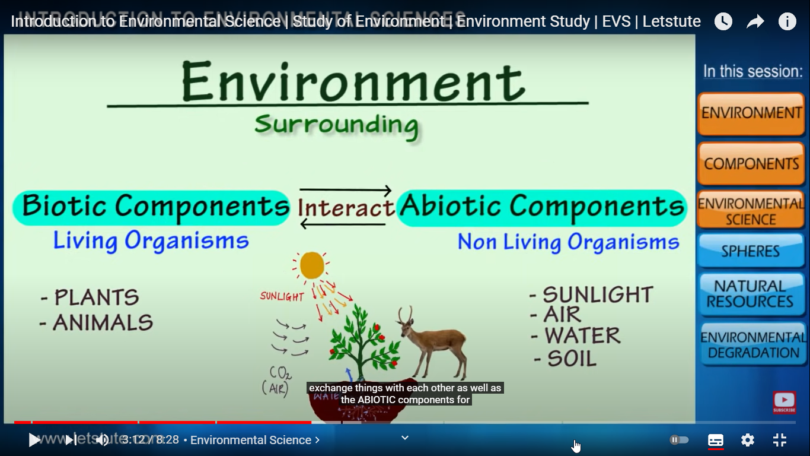
Brief Introduction about the Subject
Environmental studies are the study of human interaction with the environment and in the interests of solving complex problems.
Environment includes which we are directly or indirectly dependent for our survival, whether it is living component like animals, plants or non living component like soil, air and water.
The biologist Jacob Van Uerkal (1864-1944) introduced the term ‘environment’
Video: https://www.youtube.com/watch?v=7G3eXI_DPn8

Slide 20
Syllabus
Unit: IV
UNIT-IV (Pollution and Solid Waste Management)
Air pollution: sources of air pollution, Primary and secondary air pollutants. Origin and effects of SO_{X}, NO_{X}, CO_{X}, CFC’s, Hydrocarbon,, control of air pollution.
Water pollution: sources and types of water pollution, Effects of water pollution, Eutrophication,
Soil pollution: Causes of soil pollution, Effects of soil pollution
Noise Pollution: Major sources of and effects of noise pollution on health,
Radioactive and thermal pollution: sources and their effects on surrounding environment.
Solid waste disposal and its effects on surrounding environment
Climate change, global warming, acid rain, ozone layer depletion,

Slide 21
Content
Environmental pollution and and its types
Causes, effects control measures of Air and Water pollution, noise pollution
Causes, effects control measures of Thermal and nuclear pollution
Climate change and green house effects
Global warming
Acid rain and ozone layer depletion
Water and air borne diseases
Residual impurities in drinking water
Toxic wastes and carcinogens

Slide 22
Course Objective(CO4)
To develop proper skill required for the fulfillment of the aims of environmental education and educational evaluations

Slide 23
Course Outcome(CO4)
 | COORSE OUTCOME
CO 1 | Understand the basic principles of ecology and environment. Ecosystem: Basic concepts, components of ecosystem, food chains and food webs. Ecological pyramids | K1,K2
CO 2 | Understand the different types of natural recourses like food, forest, Minerals and energy and their conservation | K1.K2
CO 3 | Understand the importance of biodiversity, Threats of biodiversity and different methods of biodiversity conservation. | K1,K2
CO 4 | Understand the different types of pollution, pollutants, their sources, effects and their control methods. | K1,K2,K3
CO 5 | Understand the basic concepts of sustainable development, Environmental Impact Assessment (EIA) and different acts related to environment | K1,K2,K3

Slide 24
CO-PO MAPPING(CO4)
 | PO1 | PO2 | PO3 | PO4 | PO5 | PO6 | PO7 | PO8 | PO9 | PO10 | PO11 | PO12
CO 1 | - | -- | 1 | --- | --- | 1 | 2 | 1 | 1 | 1 | --- | 2
CO2 | - | -- | 1 | --- | ---- | 2 | 2 | 2 | 1 | 1 | ---- | 2
CO3 | - | -- | 2 | ---- | ---- | 2 | 2 | 1 | --- | 1 | ---- | 2
CO4 | - | - | 1 | -- | -- | 2 | 2 | 1 | 1 | 1 | -- | 2
CO5 | --- | -- | 1 | ---- | ---- | 2 | 2 | 1 | ----- | 1 | ----- | 2
Average | - | ------- | 1.2 | - | -- | 1.8 | 2 | 1.2 | 0.6 | 1 | -- | 2

Slide 25
CO-PO and PSO Mapping(CO4)
 | PSO1 | PSO2 | PSO3
CO1 | 1 | 1 | 1
CO2 | 1 | 1 | 1
CO3 | 1 | 1 | 1
CO4 | 1 | 1 | 1
CO5 | 1 | 1 | 1
Average | 1 | 1 | 1

Slide 26
Topic wise mapping(CO4)
No | Topic | Topic outcome- Students will be able to | CO mapping | Extend of mapping
1 | Environmental pollution and its types | Definition of pollution, pollutants and their types | CO4 | 1
2 | Causes, effects control measures of Air and Water pollution, | Different sourses,effects on plants, humans caused by air and water pollution | CO4 | 1
3 | noise pollution Causes, effects control measures of Thermal pollution | Different sourses,effects on plants, humans caused by noise pollution and thermal pollution | CO4 | 2
4 | Climate change and green house effects | Causes ,effects and control measure of Climate change and green house effects | CO4 | 1

Slide 27
Topic wise mapping(CO4)
No | Topic | Topic outcome- Students will be able to | CO mapping | Extend of mapping
1 | Global warming Acid rain | Causes ,effects and control measure of Global warming Acid rain | CO 4 | 1
2 | ozone layer depletion Water and air borne diseases | Causes ,effects and control measure of ozone layer depletion Water and air borne diseases | CO 4 | 1
3 | Residual impurities in drinking water Toxic wastes and carcinogen | Causes ,effects and control measure of toxic effects and carcinogens | CO 4 | 2
4 | Solid waste disposal methods and E-waste and their disposal methods | Causes ,effects and control measure of E-waste and solid waste | CO 4 | 1

Slide 28
Prerequisite and Recap
Basic knowledge of nature

Slide 29
Environmental Pollution(CO4)
Pollution-Undesirable change in characteristics of nature
Pollutants- Any materials or agents responsible for pollution are known as pollutants

Slide 30
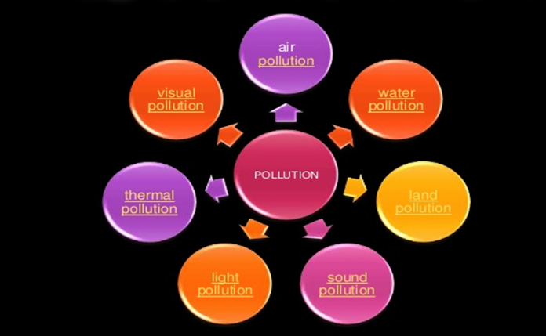
Types of Pollution(CO4)

Slide 31
Types of pollutants-(CO4)
There are following types of pollutants-
Non-biodegradable pollutants and Bio-degradable pollutants
Primary and secondary pollutants
Quantitative and qualitative pollutants

Slide 32
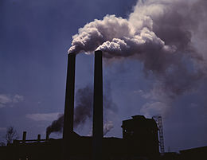
Air pollution(CO4)
Definition
Types of Air Pollutants
Cause Of Air Pollution
Gaseous air pollutants
CO, CO2, Sox, Nox etc
Particulate air pollutants
Mist, Fumes, PAN, Pb particles, Smog

Slide 33
Classification and effect of air pollution(CO4)
Primary air pollutants
Secondary air pollutants
On Humans
CO reduces the oxygen carrying capacity of blood
Sulphur dioxide cause difficulty in breathing
Suspended particulate matter can cause respiratory problems
Oxides of Nitrogen causes Headache, respiratory irritation, corrosion of teeth, loss of appetite.
Mercury damage the brain and nervous system.
Lead damage the liver ,kidney and abnormalities in fertility

Slide 34
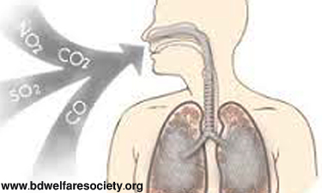
Classification and effect of air pollution(CO4)
CO causes blood poisoning leading to death
Sox causes irritation of throat and eyes, suffocation
Nox causes headache, respiratory irritation

Slide 35
effect of air pollution on plants(CO4)
SO2 are responsible for chlorosis,Necrosis,supressed growth, degradation of chlorophyll
Oxides of Nitrogen causes suppressed growth and degradation of chlorophyll
Ethylene is responsible to epinasty.

Slide 36
Control Measure(CO4)
Source control-
Using unleaded petrol
Using fuels with low sulphur and ash content
Encouraging people to use public transport, walk or use a cycle as opposed to private vehicles
Ensure that houses, schools, restaurants and playgrounds are not located on busy streets
Emission rates should be restricted to permissible levels by each and every industry
Incorporation of air pollution control equipment in design of plant layout must be made mandatory

Slide 37
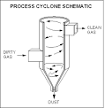
Common control devices for pollutants (CO4)
Carbon absorbers
Fabric filters or bag houses
Catalytic reactors
Electrostatic precipitators (ESPs)

Slide 38
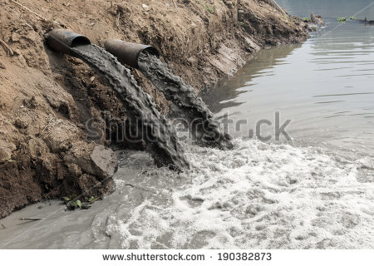
Water pollution(CO4)
The addition of harmful organic and inorganic chemicals as well as biological chemicals which change the physical and chemical properties of water is known as water pollution

Slide 39
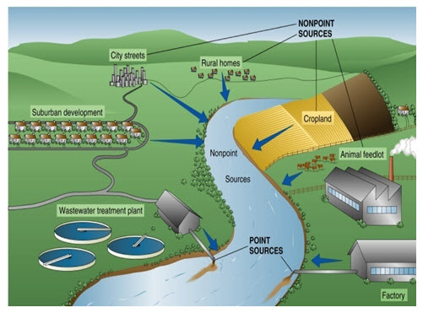
SOURSES OF WATER POLLUTION(CO4)
Point sources like municipal and industrial discharge pipes
Non-Point sources like mining runoff and acid rain

Slide 40
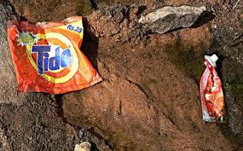

Water pollutants(CO4)
Organic pollutants
Inorganic pollutants
Suspended solid and sediments
Radioactive materials
Thermal pollution

Slide 41
Effects of water pollution(CO4)
Death of aquatic (water) animals
Disruption of food-chains
Diseases
Destruction of ecosystems
Increase in Algal Blooms
Oil Spill Ramifications
Bioaccumulative and non-biodegradable pesticides are accumulated in animal bodies.

Slide 42

Noise pollution(CO4)
Increase in the noise in the atmosphere is called sound pollution or noise pollution.
Noise is a loud and unwanted or unpleasant sound.

Slide 43
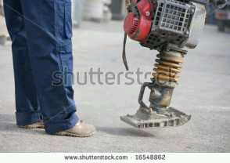
Sources(CO4)
Industrial Sources:
Transport Vehicles:
Household
Public Address System
Agricultural Machines
Defense Equipment

Slide 44
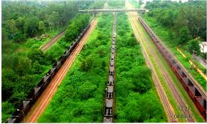

Control measures(CO4)
Construction of soundproof rooms for noisy machines in industrial and manufacturing installations must be encouraged.
Use of horns with jarring sounds, motorbikes with damaged exhaust pipes, noisy trucks to be banned.
Noise producing industries, airports, bus and transport terminals and railway stations to sighted far from where living places.
Vegetation (trees) along roads and in residential areas is a good way to reduce noise pollution as they absorb sound.

Slide 45

Soil pollution(CO4)
Soil pollution occurs when the presence of toxic chemicals, pollutants or contaminants in the soil is in high enough concentrations to be of risk to plants, wildlife, humans and of course, the soil itself.

Slide 46
Soil pollution sources(CO4)
Industrial wastes
Urban wastes
Agricultural practices
Radioactive pollutants
Biological agents
Mining sources
Construction sources

Slide 47
Soil pollution Effects(CO4)
Contaminated lands and environments can: Cause problems in the human respiratory system. Cause problems on the skin. Cause various kinds of cancers.

Slide 48
Control measures(CO4)
Proper dumping of unwanted materials:
Production of natural fertilizers
Proper hygienic condition: People should be trained regarding sanitary habits.
Public awareness
Recycling and Reuse of wastes
Ban on Toxic chemicals

Slide 49
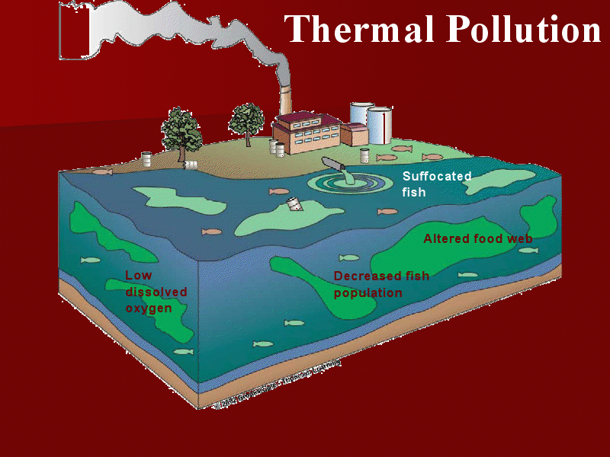
Thermal pollution(CO4..)
An increase in the optimum water temperature by industrial may be called as “Thermal Pollution”

Slide 50
Sources of thermal pollution(CO4)
Coal-fired Power Plants:
Industrial Effluents
Nuclear Power Plants:
Hydro Electric Power
Domestic Sewage:
Removal of trees along the shore line increases solar incidence and hence warms up the water along with deforestation
Dumping of waste warm water by nuclear plants.

Slide 51
Effects(CO4..)
Changed dissolved oxygen
distribution of organisms among major and minor communities.
Changes to reproductive powers and increased susceptibility to disease
Life span become shorter
Eggs and larvae of some animals die at high temperature of water.
The biodiversity of aquatic ecosystem may disturb
Oxygen concentration decreases in hot water
Warmer water also increases respiration rate i.e., aquatic animals consume oxygen faster and it increases the chance of diseases.
Rate of photosynthesis is affected.
Some aquatic animals e.g. Fishes migrate to a suitable environment.

Slide 52
Control measures(CO4..)
Cooling towers: Use of water from water systems for cooling systems for cooling purposes, with subsequent return to the water way after passage through a condenser, is called cooling process
Cooling Towers:
Artificial Lake:

Slide 53

Climate change(CO4..)
Climate is the average weather of an area. It includes general weather conditions, variations according to seasons etc
Activities related to climate change
Industrlisation
Heavy transportation
Use of fossil fuels
Population explosion
Unsustainable agriculture
Urbanization
pollution

Slide 54
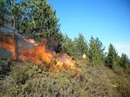
Activity related to climate change(CO4)

Slide 55
Effects of climate change(CO4..)
Extinction of species
Pollutions
Disturb in water cycles
Chances of floods and droughts increases
Global warming
Acid rain
Productivity of crop decreases.

Slide 56
Prevention(CO4..)
Cut down the current rate of use of CFCs and fossil fuels.
Use energy more efficiently.
Shift to renewable energy resourses.
Shift from coal to natural gas.
Plant more trees.
Stabilize population growth

Slide 57
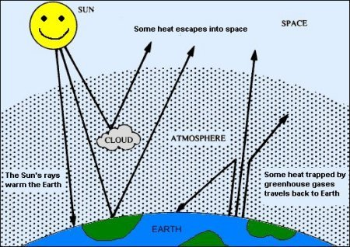

Slide 58
Green house gases(CO4..)
The GREENHOUSE GASES are very important and are mainly:
water vapor.
carbon dioxide
nitrous oxide
Ozone

Slide 59
Control measure(CO4..)
Reduction in consumption of fossil fuels such as coal and petroleum
Use of bio-gas plants
Use of nuclear power plants
Increasing forest cover
Use of unleaded petrol in automobiles
Installation of pollution controlling devices in automobiles (catalytic converter) and industries (Electro Static Precipitators, Bag filters, Wet scrubbers etc)

Slide 60
Global warming(CO4..)
Global Warming is the increase of Earth's average surface temperature due to effect of greenhouse gases, such as carbon dioxide emissions from burning fossil fuels or from deforestation, which trap heat that would otherwise escape from Earth.
Causes of global warming
Forest Fires
Man-induced Deforestation
Fossil Fuels:
Landfills- Most of the time that garbage is burnt which releases toxic gases including methane into the atmosphere and causes global warming
Overpopulation: Since carbon dioxide contributes to global warming, the increase in population makes the problem worse because we breathe out more carbon dioxide in the atmosphere.
Mining: Oil and coal are two main culprits in producing greenhouse gases

Slide 61
Prevention(CO4..)
Reduction in consumption of fossil fuels such as coal and petroleum
Use of bio-gas plants
Use of nuclear power plants
Increasing forest cover

Slide 62
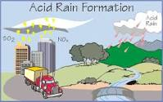
Acid rain(CO4)
Acid rain refers to a mixture of deposited material, both wet and dry, coming from the atmosphere containing more than normal amounts of nitric and sulfuric acids
Simply, it means rain that is acidic in nature due to the presence of certain pollutants in the air due to cars and industrial processes

Slide 63
Causes of Acid rain(CO4)
Heavy deforestation
More use of fossil fuels
Heavy industrialization
Transportation activity
Mining activity

Slide 64
Gases responsible for Acid rain(CO4)
CO₂
SO₂
SO₃
NO₃
Chemical Reactions
CO₂ + H₂O H₂CO₃
SO₃ + H₂O H₂SO₄
NO₂ + H₂O HNO₃
SO₂+ H₂O H₂SO₃

Slide 65
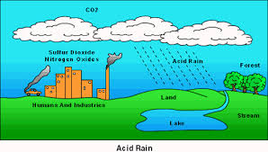
Acid rain(CO4)

Slide 66
Solution of Acid rain(CO4)
Minimize the use of high sulphur coal
Stop using fossil fuel
Encourage the use of CNG, and LPG in vehicles
Minimize air pollution
Grow more trees

Slide 67
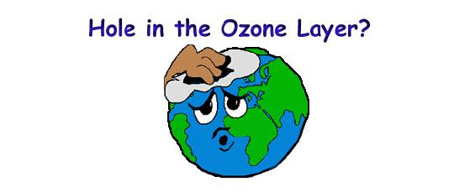
Ozone layer depletion(CO4)
One group of gases is particularly likely to damage the ozone layer. These gases are called CFCs, Chloro-Fluoro-Carbons

Slide 68
Ozone layer depletion(CO4)
CFCs are used in some spray cans to force the contents out of the can.
They are also used in refrigerators, air conditioning systems and some fire extinguishers. They are used because they are not poisonous and do not catch fire.
Chlorofluorocarbons: Used in freezers, air cooling component, dry-cleaning agents, hospital sterilants.
Methyl Chloroform:
Hydro chlorofluorocarbons:
Halons
Carbon Tetrachloride: Mainly

Slide 69
Solution of ozone layer depletion(CO4)
Minimize the use of high sulphur coal
Stop using fossil fuel
Encourage the use of CNG, and LPG in vehicles
Minimize air pollution
Grow more trees

Slide 70
Solid Waste Management(CO4)
Solid Waste comprises of all the waste arising from human and animal activities that are typically solid and that are discarded as useless or unwanted. It is all-inclusive of the heterogeneous mass from the urban community as well as more homogeneous accumulation of agriculture and industrial wastes.
Some of commonly used synonyms for solid wastes are:
Refuse: This is a more appropriate term for solid waste as most waste can be utilized as a raw material for some other purpose.
Garbage: It consist of kitchen wet waste.
Rubbish: Those waste with high ash content.
Scrap: Wastes that have high metal content.
Debris: Bulky wastes such as construction waste.

Slide 71
Solid Waste Management(CO4)
Types of Solid Waste:
Municipal Wastes: which includes garbage or food wastes, ashes and residues, construction and demolition wastes, treatment plant wastes, special wastes.
Industrial Wastes: which includes all types of liquid or solid waste generated from different types of industries.
Hazardous Wastes: are waste (liquid, solid, gaseous or sludge) that is dangerous or potentially harmful to our health or environment. They can be discarded commercial products, byproducts from industries, or from households.

Slide 72
Faculty Video Links, Youtube & NPTEL Video Links and Online Courses Details
Self Made Video Link:
Youtube/other Video Links
https://www.youtube.com/watch?v=7qkaz8ChelI, https://www.youtube.com/watch?v=NuQE5fKmfME, https://www.youtube.com/watch?v=9CpAjOVLHII, https://www.youtube.com/watch?v=yEci6iDkXYw, https://www.youtube.com/watch?v=yEci6iDkXYw

Slide 73
Weekly Assignment(CO4)
1.What is meant by environmental pollution? Discuss the requirement of a non polluted environment.
2.What are the causes of environmental pollution? List all environmental pollutants and their sources.
3. Define water pollution and enlist various sources of water pollution. What are the effects of water pollutants on humans.
4. Define Air pollution and enlist various sources of air pollution. What are the effects of air pollutants on humans and on nature.
5. Describe the causes, effects of soil pollution which effect the soil productivity.
6. Discuss the causes, effects and control measures of noise pollution.
7. Define Thermal pollution and enlist various sources of Thermal pollution.
.8 Discuss the causes and effects of climate change?
9. Write short notes on causes, consequences and remedial measures of Green house effects?
10. Discuss the causes , effects and control measure of acid rain?
11. What is meant by ozone shield? How CFC and ozone depleting substances affect ozone shield?

Slide 74
MCQ s(CO4)
1. Among the following, the only secondary pollutant is:
(a) Sulphur tetra oxide (b) Ozone
(c) Carbon monoxide (d) Sulphur dioxide
Answer-b
2. The major photochemical oxidant is:
(a) Hydrogen peroxide (b) Ozone
(c) Nitrogen oxides (d) Peroxyl acetyl nitrate(PAN)
Answer ---c
3. The highest heating value is of:
(a) Garbage (b) Rubbish
(c) Hospital waste (d) Agricultural wastes
Answer---b
4.Which of these is a management option for air pollution:
(a) Regulation and standard (b) Emission changes
(c) Transport planning (d) All of the above
Answer---d
Answer---
5. Increase in fauna and decrease in flora would be harmful due to increase in?
(a) Disease (b) CO2
(c) O2 (d) Radioactive pollution
Answer---b

Slide 75
Old Question Papers
New syllabus autonomous

Slide 76
Expected Questions for University Exams(CO4)
1.What is meant by environmental pollution? Discuss the requirement of a non polluted environment.
2.What are the causes of environmental pollution? List all environmental pollutants and their sources.
3. Define water pollution and enlist various sources of water pollution. What are the effects of water pollutants on humans.
4. Define Air pollution and enlist various sources of air pollution. What are the effects of air pollutants on humans and on nature.
5. Describe the causes, effects of soil pollution which effect the soil productivity.
6. Discuss the causes, effects and control measures of noise pollution
7. Define Thermal pollution and enlist various sources of Thermal pollution. What are the effects of thermal pollution on water bodies.

Slide 77
Summary(CO4)
Sources of air pollution
Natural pollution - volcanic eruptions, forest fires, biological decay.
Man – made activities – Thermal power plants, agricultural activities.
Classification---Primary pollutant – these are those emitted directly in the atmosphere in harmful form like CO, NO.
Secondary pollutant – these may react with one another or with the basic components of air to form new pollutants.
It may be defined as “the alteration in physical, chemical and biological characteristics of water which may cause harmful effects on human and aquatic life.
Types, effects and sources of water pollution
Infectious agents:
Example: Bacteria, viruses, protozoa and parasitic worms.
Sources: Human and animal wastes.
Effects: Variety of diseases.

Slide 78
Summary(CO4)
It may be defined as “the contamination of soil by human and natural activities which may cause harmful effects on living beings”. Types
Industrial wastes
Sources: Pulp and paper mills, chemical industries, oil refineries, sugar factories,tanneries, textile, steel, fertilizers etc.
Effects: Affect and alter the chemical and biological properties of soil.
Hazardous chemicals enter into human food chain from the soil and finally lead to serious effects.

Slide 79
References
1. Environmental studies and Environmental engineering –By Dr. H.H.Singh
2. A Text Book of environmental Science By Shashi Chawala
3. Environmental Studies By Dr B.S.Chauhan

Slide 80
Noida Institute of Engineering and Technology, Greater Noida
Thank You

